Slide 1
Community for Emerging and Zoonotic Diseases
Identifying emerging risks through collective intelligence
CEZD – CAHSS Poultry Update
10 April 2025
www.cezd.ca

Slide 2
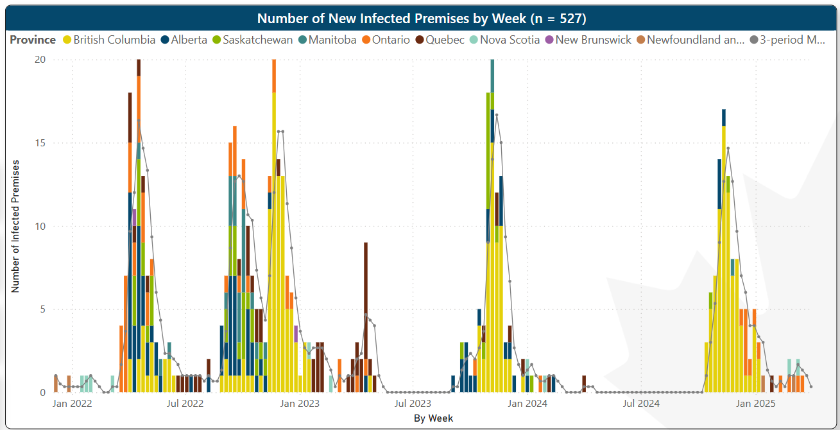
HPAI in Domestic Birds in Canada
2024
2025
2022
2023
2021
D1.1
May 1,
2025
April 1,
2024
March 24, 2025
Microsoft Power BI
Last updated April 2, 2025
Notes:
Spring and Summer 2024 were free of domestic cases of HPAI.
New cases started to be reported on Oct 21st in BC and have been tailing off.

Slide 3
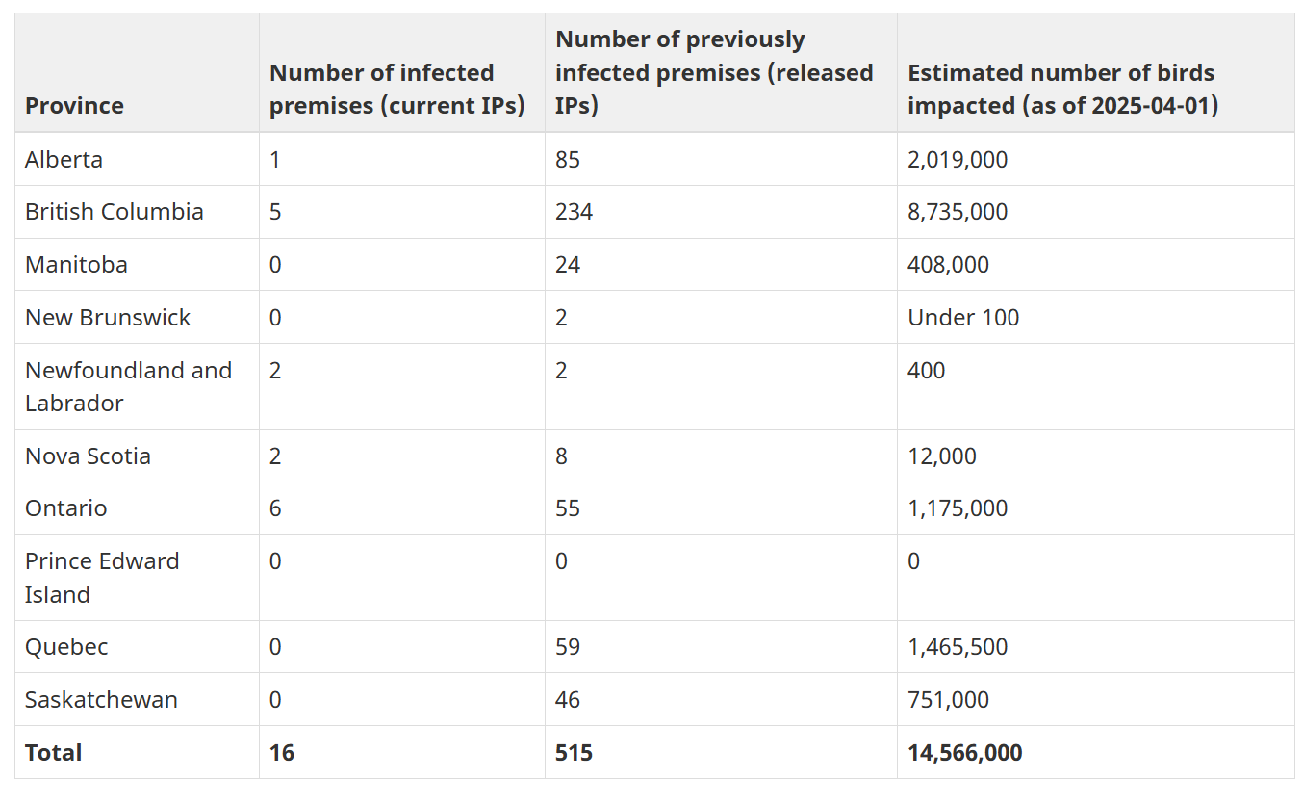
Status of ongoing avian influenza response by province - inspection.canada.ca
16 IPs active – as of April 7, 2025

Slide 4
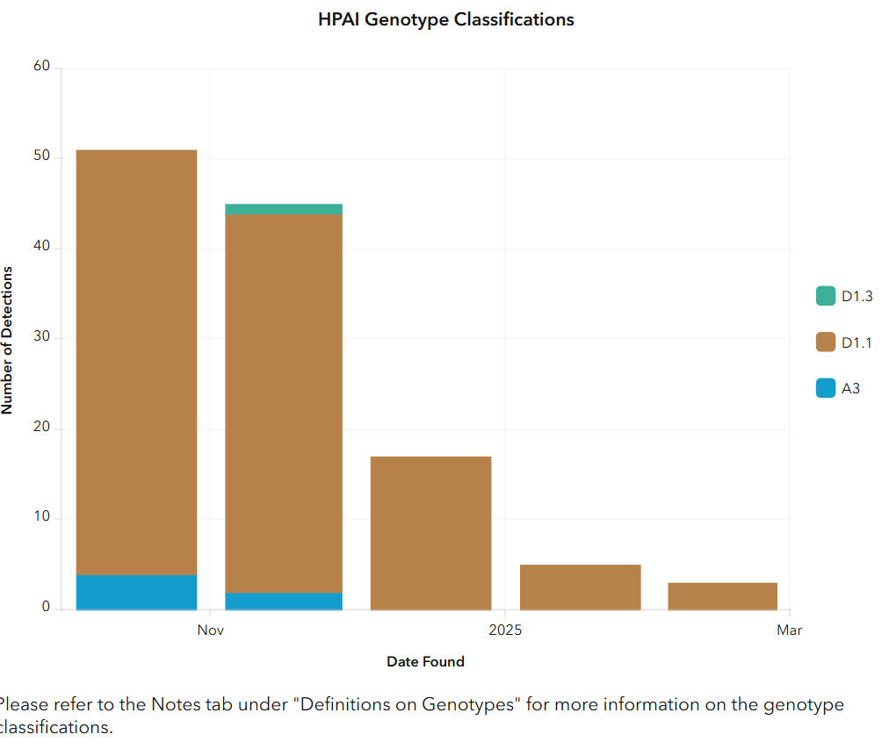
H5N1 Dominant Variant in BC Fall to Spring 2025
H5N1 2.3.4.4b D1.1
Eurasian virus (HA) that arrived via the Pacific Flyway
Reassorted with a North American LPAI
BC Dashboard
accessed April 9th

Slide 5
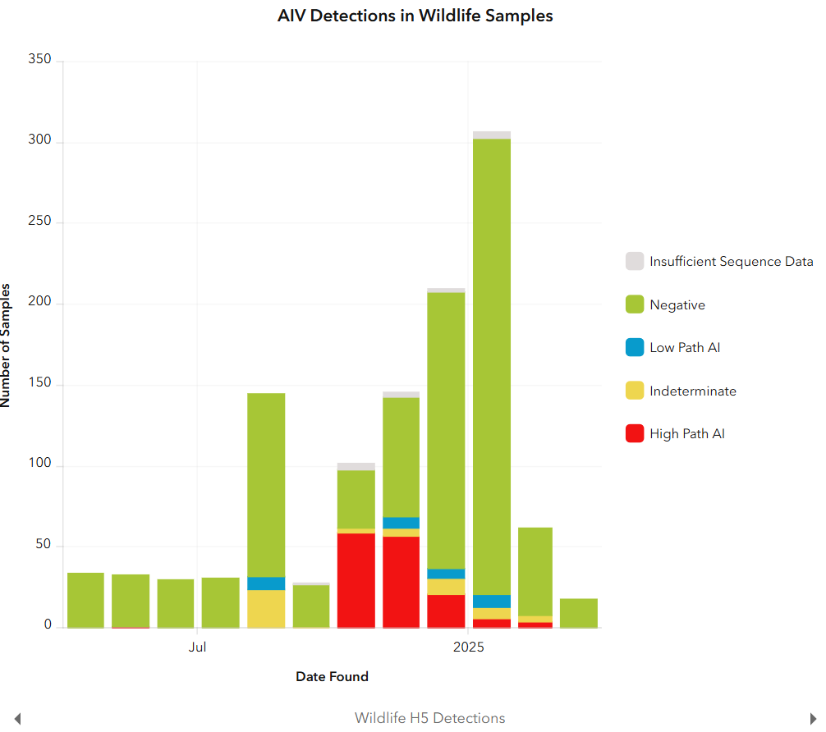
HPAI detections in wild birds declining
BC Dashboard
Accessed April 9th
Last green bar 18 tests on wild birds and all negative

Slide 6
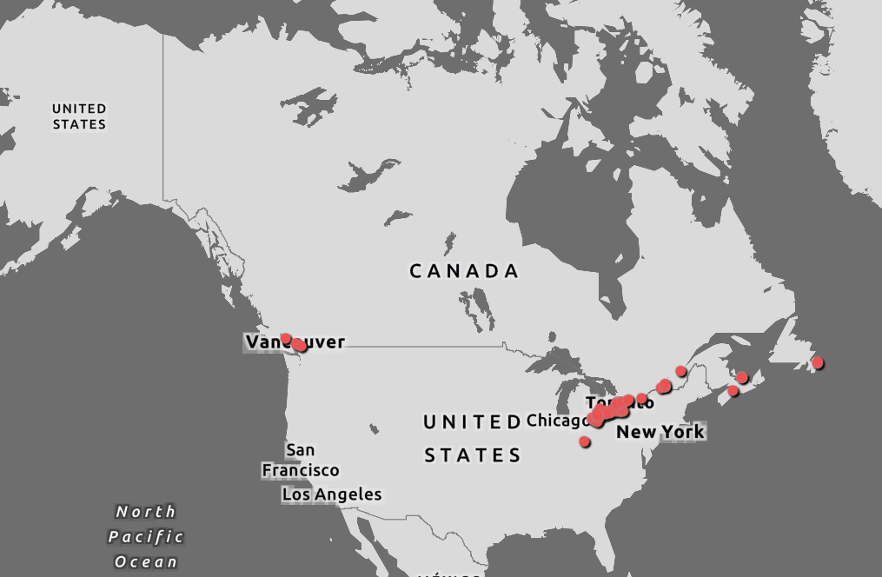
Wildlife HPAI
Dashboard Filtered from Dec 7, 2024 – Apr 9, 2025
82 new confirmed cases
3 H5N5 in Newfoundland Black-backed gull and Herring Gull
CWHC
Wild Bird Dashboard

Slide 7
HPAI in Canadian Wild Birds
CWHC Wild Bird Dashboard

Slide 8
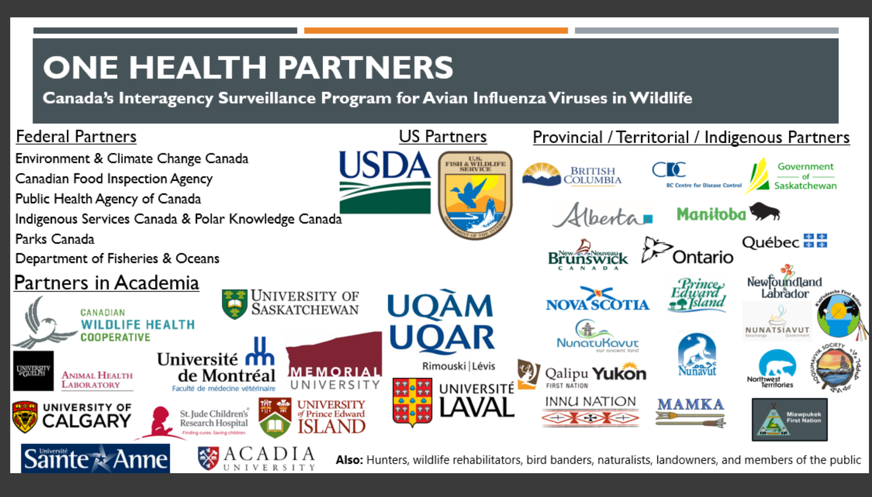
Surveillance Partners

Slide 9
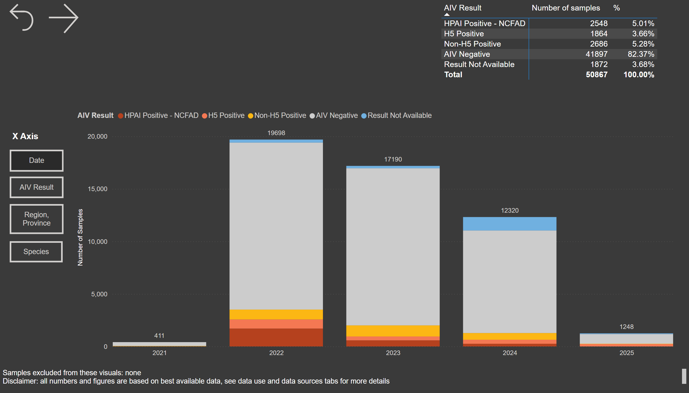
Virus Surveillance: Summary Tables/Figures

Slide 10
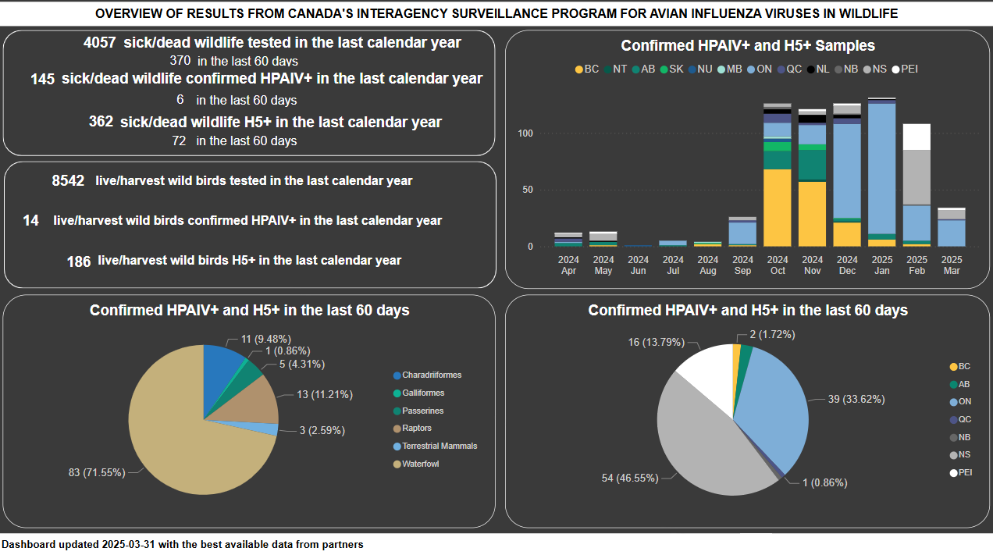

Slide 11
US Domestic Poultry Cases
Notes:
We have seen a decline in cases year over year, but the US is not seeing the same declines.
Remember that they have B3.13 in dairy cattle, that we do not and there are a significant number of cases of B3.13 that have jumped from dairy to poultry

Slide 12



IP with domestic birds – Canada vs USA
As of April 7, 2025
281
718
131
342
315
299
98
15
Notes:
Initially, same trends Can – USA, but lately with HPAI in dairy cattle in the USA, poultry cases are on the rise.
In Canada, we see a reduction of cases overtime. Fraser Valley remains a concern.

Slide 13
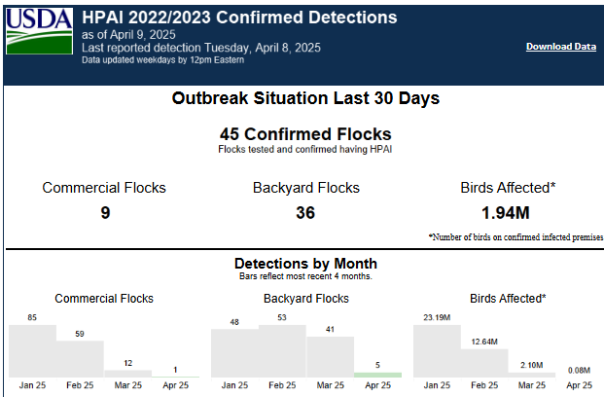
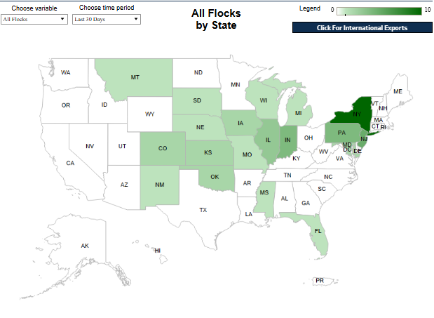
United States – HPAI Domestic Bird Detections Last 30 days
9 Commercial
36 Backyard Flocks
~1.9 million birds
Confirmations of Highly Pathogenic Avian Influenza in Commercial and Backyard Flocks | Animal and Plant Health Inspection Service (usda.gov)
Notes:
Canada has only had 4 detections in the last 30 days, last one March 24th.

Slide 14
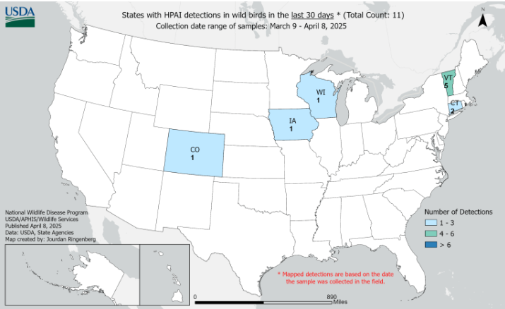
US Wild Bird HPAI Detections, March 9 – April 8, 2025
11 wild bird detections of HPAI in the last 30 days
Uncertain genotyping and unknown number of birds tested
HPAI Detections in Wild Birds (usda.gov)

Slide 15
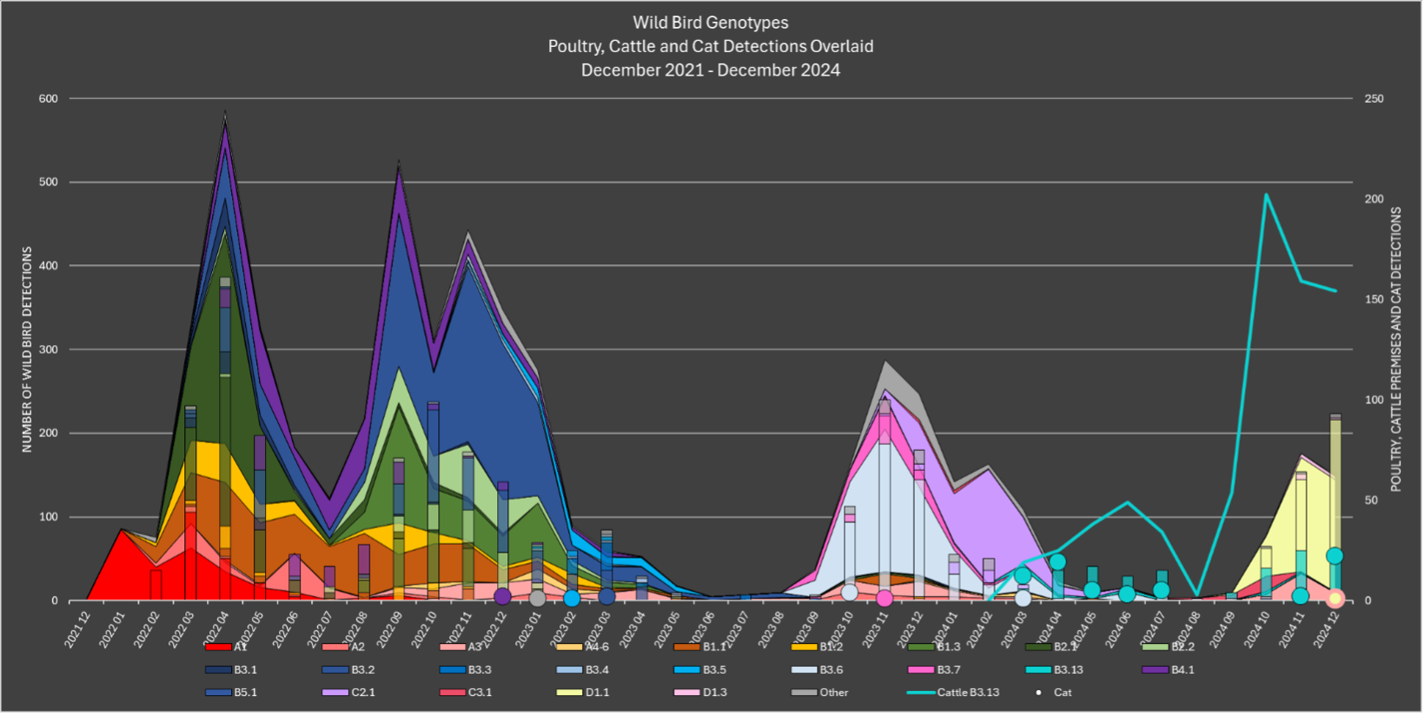
Genotypes of HPAI in United States
GitHub - USDA-VS/GenoFLU: Influenza data pipeline to automate genotyping assignment

Slide 16
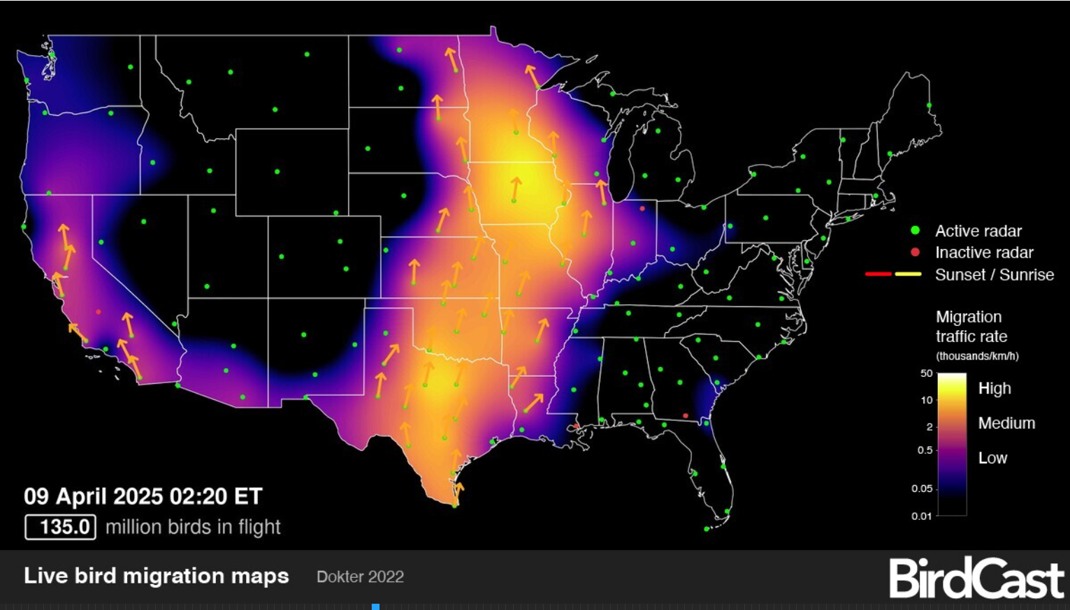
Wild bird migration well underway
BirdCast
Notes:
Wild bird migration is well underway

Slide 17
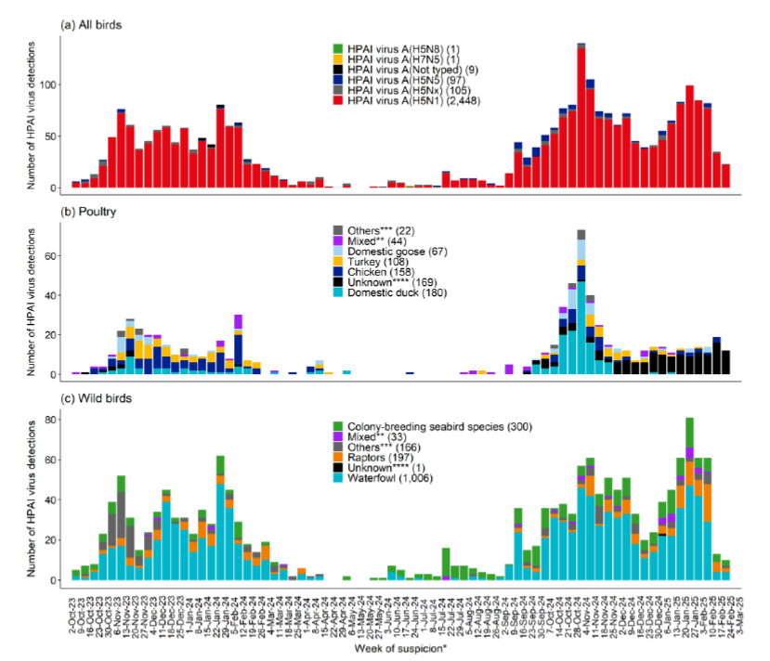
European Union
2023
2024
2025
90% of poultry cases are genotype EA-2024-DI.x (not the same as our D1.x)
Less genetic diversity that the previous year
2024-25 worse than 2023-24

Slide 18
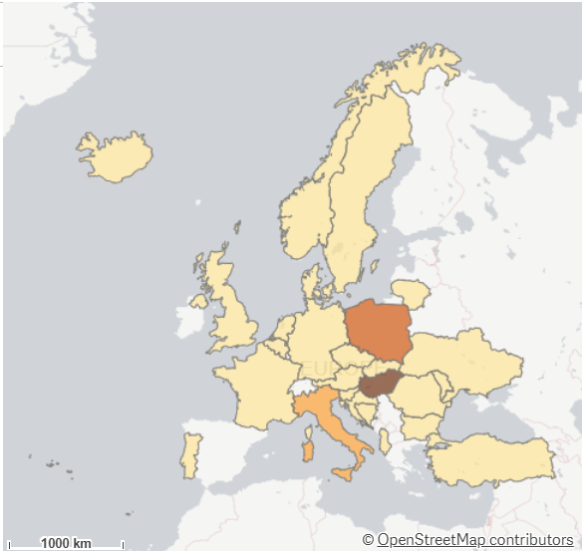
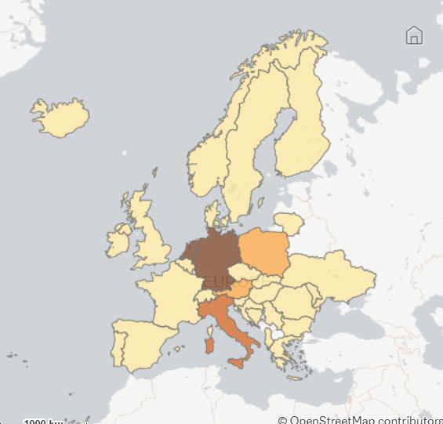
Europe – Domestic Birds
Europe – Wild Birds
437 outbreaks in 27 countries
(since September)
  878 outbreaks in 32 countries
  (since September)
EURL Avian Flu Data Portal
Notes:
Farmed bird cases have stayed high Jan to April 245 outbreaks in 22,
Wild bird cases are similar, stayed high Jan to April with 448 outbreaks in 29 countries

Slide 19
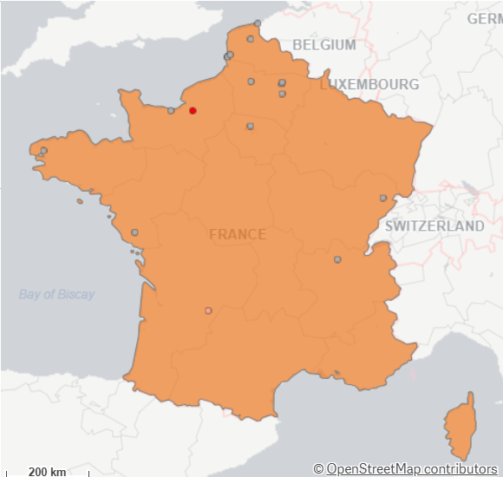
HPAI France
  Vaccinated duck flock in France hit by avian flu | WATTPoultry.com – January 2025
  Since January 1st, two domestic cases in France
  News reports of new round of vaccinations for ducks
  Does anyone have more information on what is happening in France with vaccinations?
  How do changing genotypes impact vaccination efficacy?

Slide 20
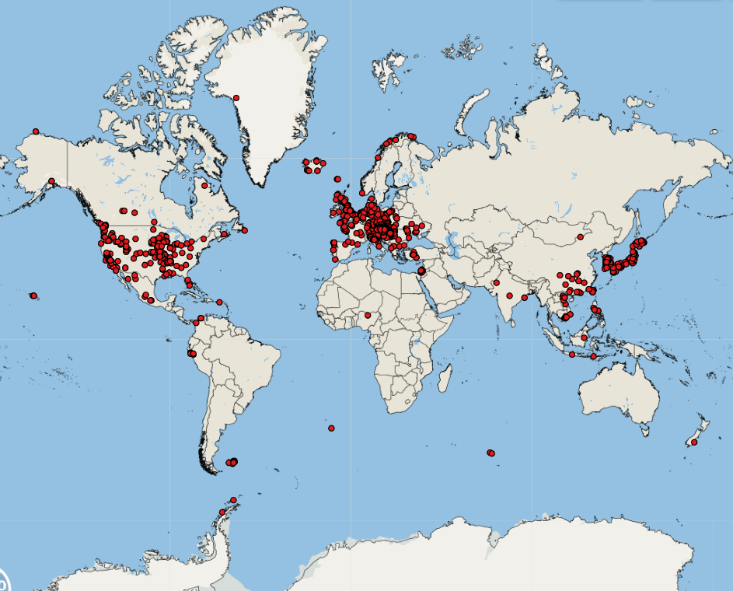
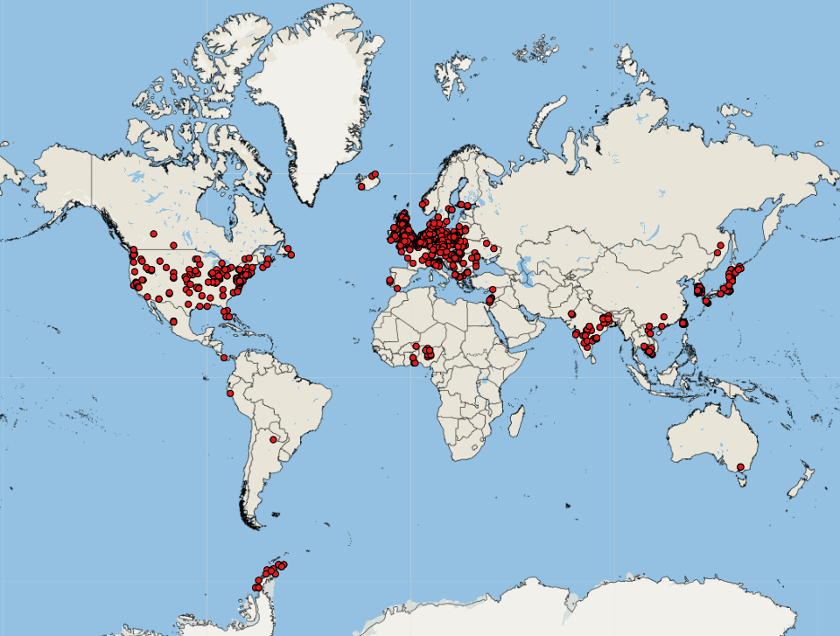
Global cases of Avian Influenza (all strains)
September 1-December 31 2024
January 1, 2025 to today

Slide 21
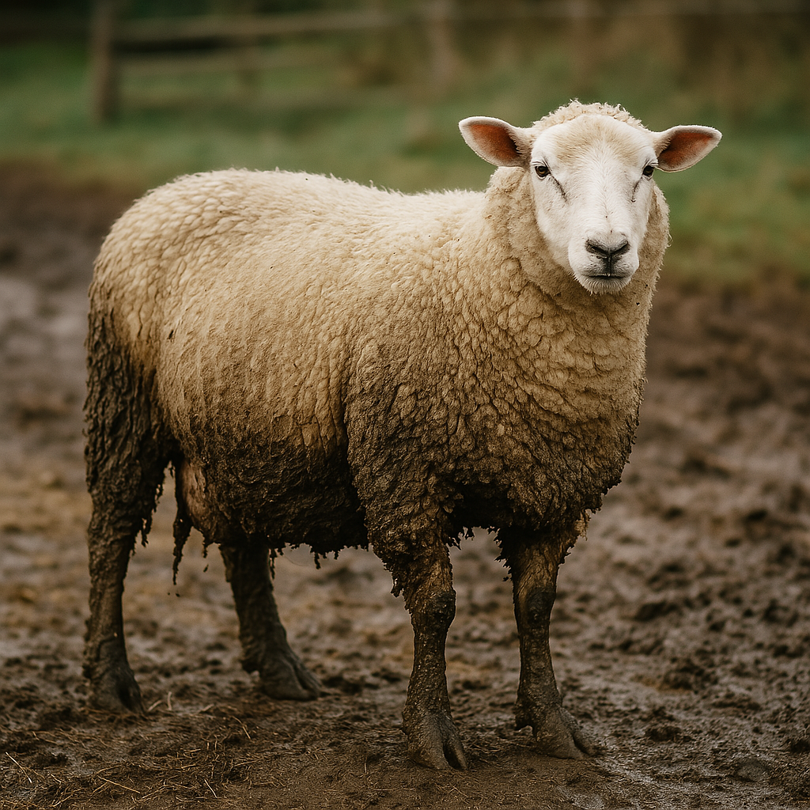
Influenza of avian origin confirmed in a sheep in Yorkshire - GOV.UK
Mixed species small farm
Housed chickens, ducks, turkeys and geese
26 sheep (1 ram, 25 ewes)
1 ewe positive for HPAI on serology was culled
  PCR positive in milk
  ELISA positive blood
  Negative PCR on other tissues
All other animals, including her nursing lambs, were negative

Slide 22

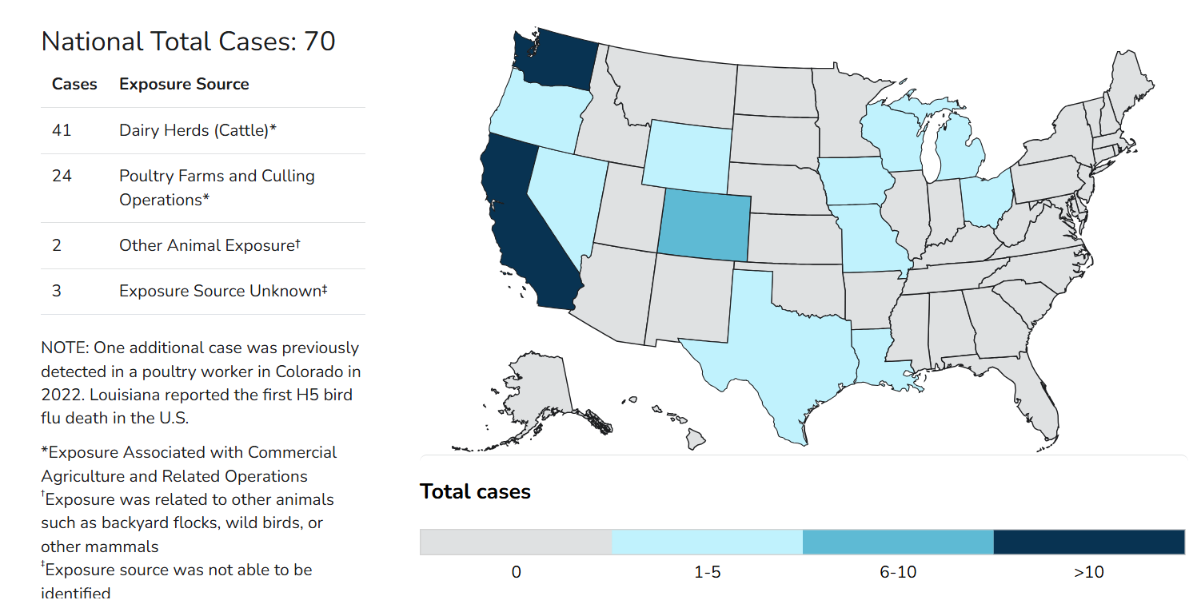
Human Cases Continue to be Reported
https://www.cdc.gov/bird-flu/situation-summary/index.html?cove-tab=0

Slide 23
Recent International Cases in Humans
Cambodia reports third fatal human H5N1 case of the year | CIDRAP
  3 year old boy
  Family had consumed sick/dead poultry
AP Reports First Bird Flu Death as 2-Year-Old Succumbs to H5N1
  Indian child
  Had consumed raw chicken
Mexico records first human death from H5N1 bird flu | News.az
  3 year old girl
  No known poultry/wild bird exposure

Slide 24
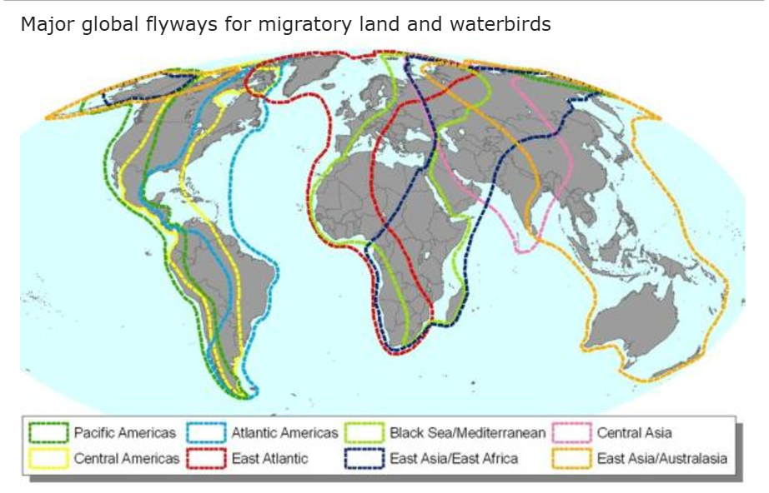
What will happen this spring?
Birds from all flyways infected – D1.1 is dominant in the US
Spring Migration – smaller number of birds than fall
Populations exposed to D1.1, should be some level of population immunity present = decreased infection pressure
US has had a terrible winter/spring
We don’t have their B3.13 risk from Dairy
Pattern previously seen in N. America has fewer cases in the springtime
What are your thoughts?

Slide 25
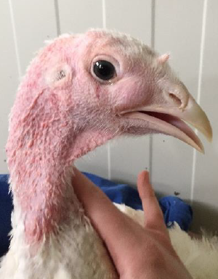
AMPV vaccine import approvals
Canadian Centre for Veterinary Biologics VB-GL-3.21.2: Importation of unlicensed veterinary biologics manufactured in a foreign country – inspection.canada.ca
USDA approves import of Zoetis Vaccine
  Zoetis' Poulvac TRT

Slide 26
Scientific Findings
Mapping of stakeholders in avian influenza surveillance in Canada
H5N1 avian flu is spreading rapidly in Antarctica
Antarctic expedition confirms the spread of the highly pathogenic avian influenza virus in the Weddell Sea
Please consult the weekly CEZD reports for scientific findings

